Slide 1
ME469: A Verification and Validation (V&V) Methodology
Stefan P. Domino^{1,2}
¹ Computational Thermal and Fluid Mechanics, Sandia National Laboratories
² Institute for Computational and Mathematical Engineering, Stanford
SAND2018-4536 PE

Slide 2
Verification and Validation Objectives
Introduce and Discuss:
Elements of a Poor/High-Quality Verification Study
Elements of a Pool/High-Quality Validation Study
Overview of a Phenomena Identification Ranking Table (PIRT)
Cast within a fire safety use case
Solution Verification
The Role of Code Verification, including the Method of Manufactured Solutions (MMS)
Code Verification: Value Proposition
Review

Slide 3
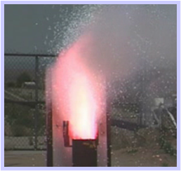
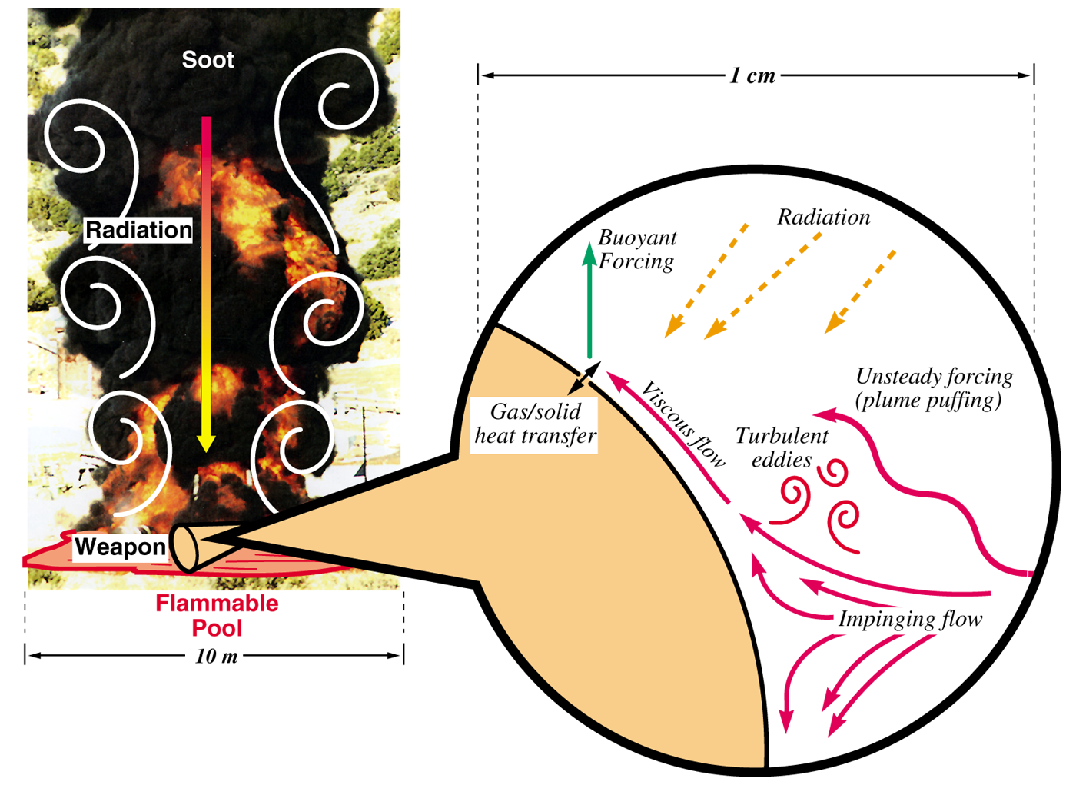
Our Exemplar: Heat Transfer Mechanisms: Abnormal/Thermal Environment (ATE)
Characterized by a highly sooting, turbulent reacting flow with participating media radiation (PMR) and conjugate heat transfer (CHT) multi-physics coupling
Liquid fuels, e.g., JP-8, are common due to its usage in transportation, however, propellants (point-Lagrangian/Eulerian) and composite (heterogeneous combustion) also encompass the ATE
Propellant upward burn
object
[1] https://en.wikipedia.org/wiki/2008_Andersen_Air_Force_Base_B-2_accident
Anderson Air Force B-2 Accident (2/2008)

Slide 4
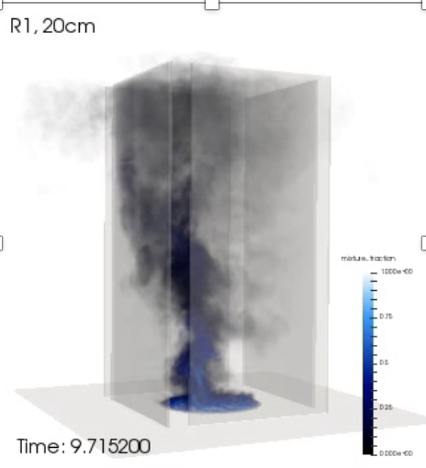
Objective: Deploy a High-Fidelity Tool to Predict a Fire with External Flow Coupling
Consider that we want to develop and deploy a foundational understanding in, e.g., fire physics and deploy a simulation tool to support production analysis
Let us introduce the fire-environment with elements of the following physics:
Chemical reactions, soot, buoyancy, turbulent fluid mechanics, thermal radiation heat transfer, convective heat transfer, object heat-up/response, and sometimes propellants
As mixing increases, accurately capturing convective heat loads becomes important
This perspective and definition defines our ”conceptual” model
Volume-rendered
mixture fraction

Slide 5
Verification vs Validation (V&V)? The Formal Lexicon (REVIEW)
Verification: Are we solving the equations correctly?
Represents an exercise in computational mathematics
Given an equation, is the solution converging at known rates?
Validation: Are we solving the correct equations?
Represents an exercise in understanding the physics associated with the real world use case
In this course, we will strongly focus on verification
Establishing the correctness of the numerical implementation is key
Comparisons of the numerical results to reality is not the primary objective
Verification challenges?
Knowledge of the true solution, i.e., exact analytical solutions
How many exact solutions exist for our class of physics? Not many!
Hint: Method of Manufactured Solutions (MMS)

Slide 6
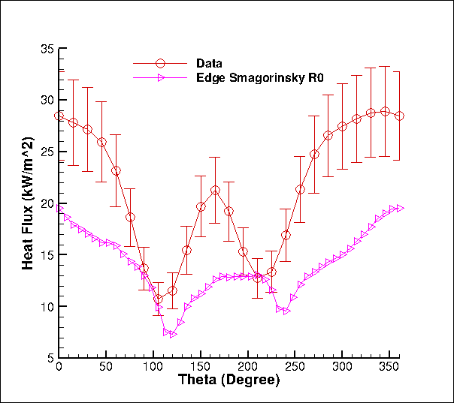
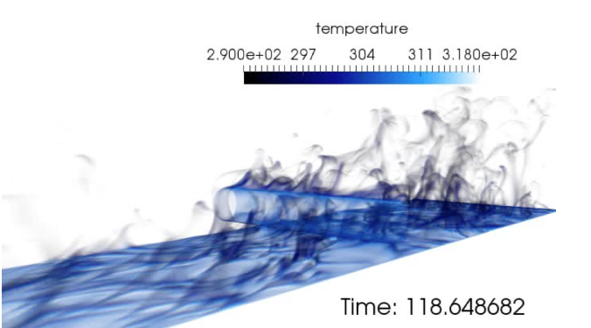
Challenge: Understanding Errors/Uncertainties….
One mesh, one model, unknown code/numerical pedigree…
We need to distinguish the types of errors/uncertainties:
Conceptual uncertainty, δ_{input}
Model-form error/uncertainty, δ_{model}
Discretization Error, δ_{numerical}
Code Error, δ_{numerical}
What credible scientific hypothesis can be tested in this context?
Heat flux to the cylinder
Volume-rendered temperature
Time-averaged heat flux to cylinder

Slide 7
Does a Process Exist? Phenomenological Identification and Ranking Table (PIRT)
A Phenomenological Identification and Ranking Table (PIRT) is:
A process that defines 1) what you know, 2) what you think you know, and 3) what “you know not of”
Legacy to the United States Nuclear Regulatory Commission (NRC), “The Phenomena Identification and Ranking Table (PIRT) process is a systematic way of gathering information from experts on a specific concept, and ranking the importance of the information, in order to meet some decision-making objective” [1]
Extensively used in the planning of high-consequence mod/sim/exp plans
[1] “Quantifying Reactor Safety Margins: Application of CSAU to a LBLOCA,” B.E. Boyack, et al, Part 1: An overview of the CSAU Evaluation Methodology; G.E. Wilson et al., Part 2: Characterization of Important Contributors to Uncertainty, W. Wulff et al., Part 3: Assessment and Ranging Parameters; C.S. Lellouche et al., Part 4: Uncertainty Evaluation of analysis Based on TRAC-PF1/MOD1; N. Zuber et al., Part 5: Evaluation of Scale-up Capabilities of Best Estimate Codes; I. Catton et al., Part 6: A Physically Based Method of Estimating PWR LBLOCA PCT, Nuclear Engineering and Design 119 (1) pp 1-117, May 1990.

Slide 8
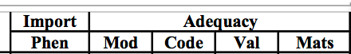
Step 1: Phenomena Identification and Ranking Table (PIRT)
Identify all salient physics and rate the following:
The importance of the phenomenon
Adequacy of Models
Adequacy of Code (does the code have the required models; has the code been “verified”)
Adequacy of Validation (do we believe that the models capture the physical world)
Once a particular use-case is understood and a PIRT is complete, one can proceed down the path of simply closing the gaps in the modeling, code implementation, and model validation process
Example: Convective heat transfer:
We believe that we have a good understanding of the models, and the code seems to have the models that we want implemented (given our current understanding)
However, high-quality validation experimental data is missing
Investment: Experimental campaign for mixed-convective heat transfer

Slide 9
Review of the Method of Manufactured Solutions (MMS): Providing confidence that the code implementation converges to the proper solution
We understand that the number of analytical solutions to test our code implementation are very few in number
How can we test the numerical accuracy of our implementation that, in general, solves very complex physics?
Specifically, as we refine the mesh and time step, how does the error respond?
Consider a simple heat conduction PDE:
With given [steady] manufactured solution:
New, analytically modified system that includes a new source term that we can implement in the code base:
The error is computed to be the difference between the analytical, or manufactured solution and our numerical simulation, T^{h}
We can now refine the mesh and timestep, while computing the error to ensure that the rate of reduction is expected
For example, if we believe our scheme is 2nd or 3rd order in space accuracy, one uniform refinement should reduce the error by 4x or 8x, respectively

Slide 10
Review of the Method of Manufactured Solutions (MMS): Providing confidence that the code implementation converges to the proper solution
We understand that the number of analytical solutions to test our code implementation are very few in number
How can we test the numerical accuracy of our implementation that, in general, solves very complex physics?
Specifically, as we refine the mesh and time step, how does the error respond?
Consider a simple heat conduction PDE:
With given [steady] manufactured solution:
New, analytically modified system that includes a new source term that we can implement in the code base:
The error is computed to be the difference between the analytical, or manufactured solution and our numerical simulation, T^{h}
We can now refine the mesh and timestep, while computing the error to ensure that the rate of reduction is expected
For example, if we believe our scheme is 2nd or 3rd order in space accuracy, one uniform refinement should reduce the error by 4x or 8x, respectively

Slide 11
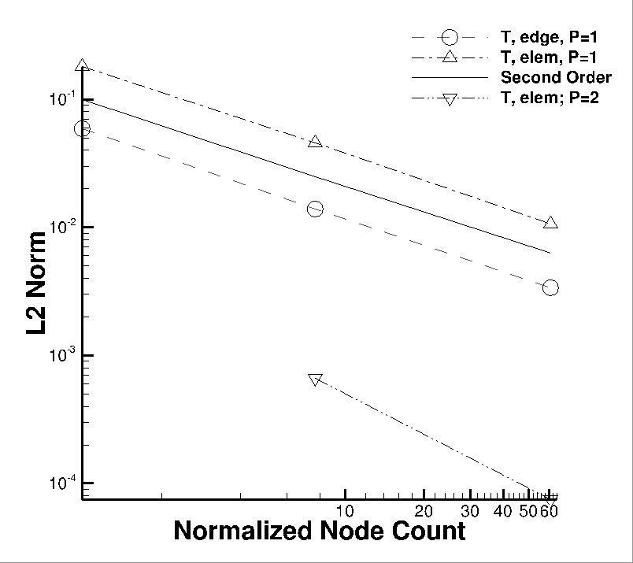
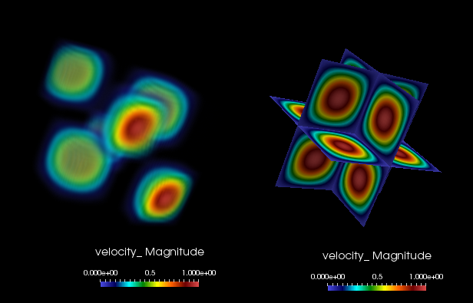
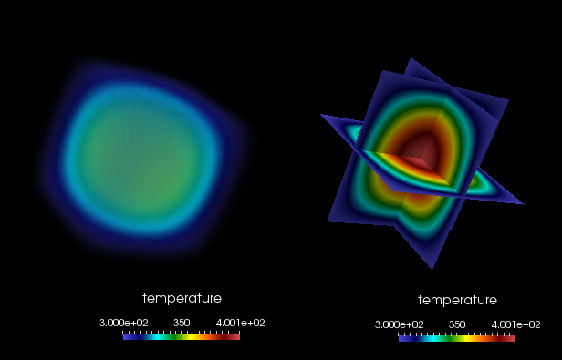
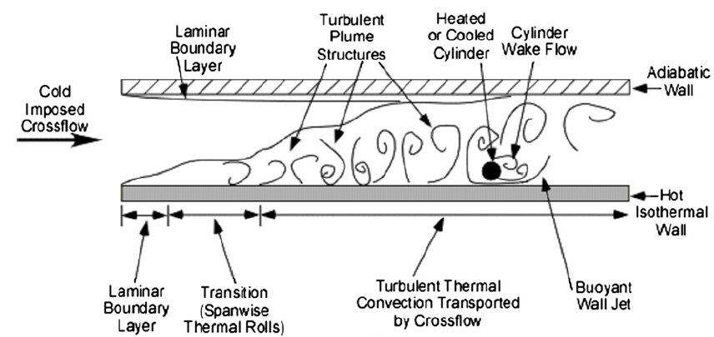
Spatial Code Verification for a low-Mach, Variable-Density Flow
Density is a function of static enthalpy transport via the standard ideal gas, ρ = f(P,M,R,T)
Temperature range maps to experiment (see below)
Arbitrary buoyancy source term via rotated gravity vector
Collective study now provides confidence in the interplay between numerical and modeling accuracy
See, “Exploring model-form uncertainties in large-eddy simulations”, Domino et al, 2016
Velocity Mag
Temperature
Kearney experimental configuration

Slide 12
Solution Verification
Wait, we have a verified code base, however, are running a physics that, while maps to the verification problem, does not have a known solution….
Solution Verification: The process by which we establish that the numerical error associated with a simulation study is quantified
We may be seeking a quantity of interest such, e.g., heat flux to an object, a velocity profile that is of interest, pressure field, drag coefficient, etc.
Ideally, as we refine the mesh, we will see a reduced error
However, an error relative to what? An experiment? Another code result? The other simulations?
Formally, the product of a solution verification study is a convergence rate for a quantity of interest
Richardson Extrapolation: Obtain a series of simulations (that are sufficiently resolved) that are combined to extrapolate to a higher-order solution estimate (given an order of accuracy assumption)
See: Roache, P.J. and Knupp, P.M. (1993), Completed Richardson extrapolation. Commun. Numer. Meth. Engng., 9: 365-374. https://doi.org/10.1002/cnm.1640090502
In practice, most quality studies meet the concept of “solution sensitivity”, i.e., how does the solution vary based on the refined mesh spacing and time step?

Slide 13
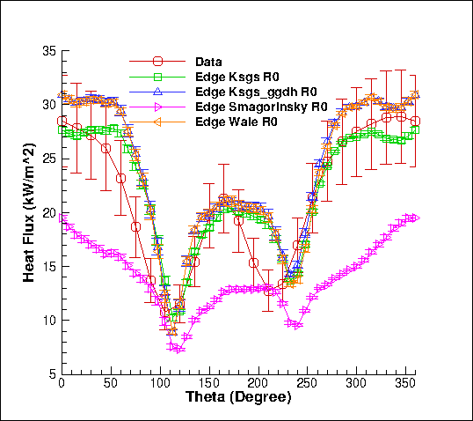
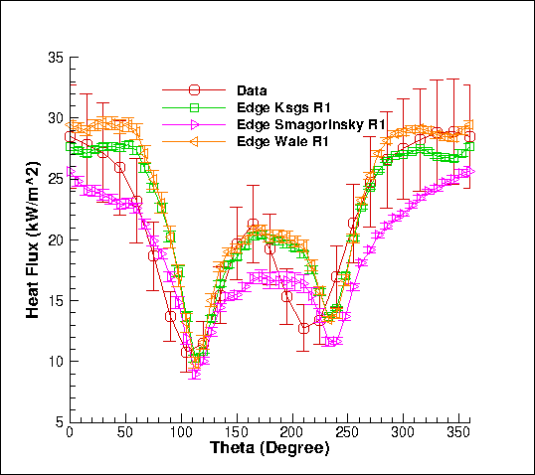
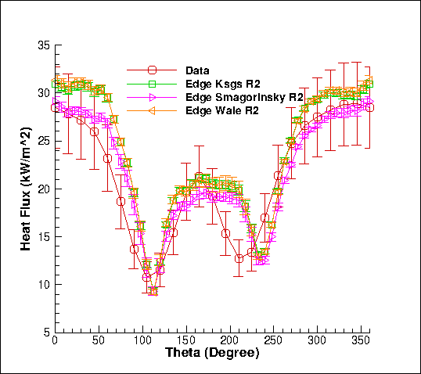
Solution Sensitivity & Due Diligence for Model-form (Structural) Uncertainty
Three meshes (solution sensitivity)
Three models (structural uncertainty)
The heat flux results also show error bars due to time and spatial averaging over a line-of-site
Can we yet feel confidence in any scientific statement? (much closer)

Slide 14
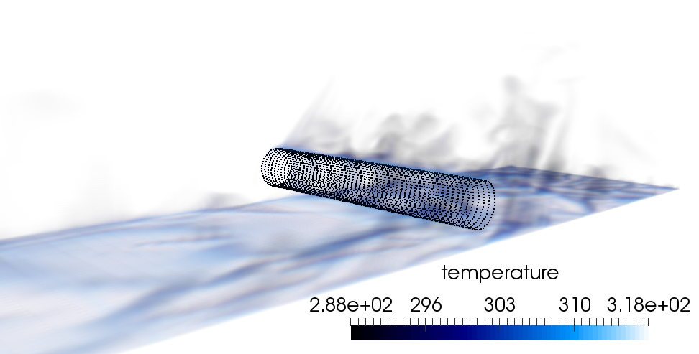
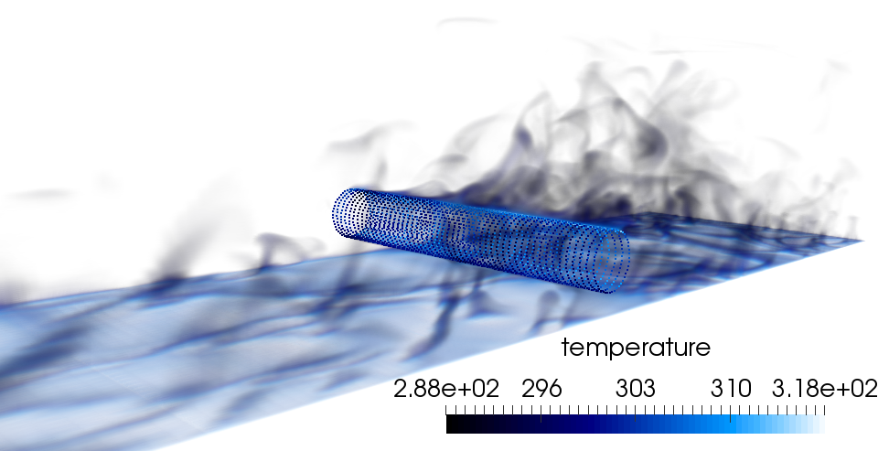
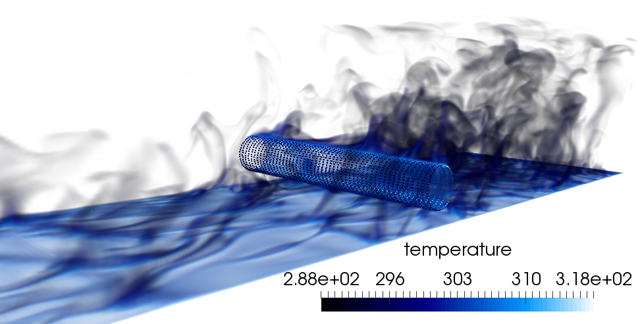

The Effect of Polynomial (P) and Mesh Spacing (H) Refinement
For the heated cylinder-in-cross flow, either mesh resolution or polynomial promotion provides a more accurate result with more turbulence structure noted
P=1, R0
P=1, R1
P=1, R2
P=2, R0

Slide 15
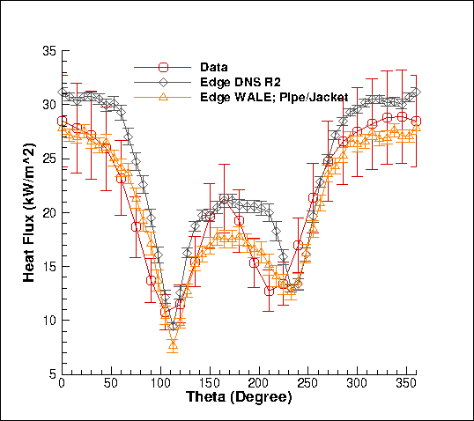
Review Case and Conceptual Model: Why are we not converging to the experimental result?
Model Configuration: SNL-based Sean Kearney Experiment, “Experimental investigation of a cylinder in turbulent convection with an imposed shear flow”, AIAA, 2005
Experiment: Outer crossflow, outer cylinder wall, inner hot fluid
QoI: Heat flux… How was that obtained?
Inverse analysis! Experiment measured temperature and inferred heat flux; an additional error/uncertainty
Iteration on the conceptual model? Add two fluid regions and a CHT coupling to remove the usage of removed the conceptual error an usage of the inverse wall temperature…
Still not perfect, however, we have included many forms of uncertainty in the simulation study
Inflow velocity, wall temperature, etc. are more options

Slide 16
Review of a Strong V&V Process
Numerical UQ
Establish a sound LES-based V&V process (with uncertainty quantification) that includes the following attributes:
Phenomena Identification and Ranking (PIRT)
Code and solution verification (numerical error, δ_{numerical})
Validation including solution sensitivity to model inputs (δ_{input})
Structural uncertainty (model form error, δ_{model})
Physics assumptions (your conceptual model)
Structural UQ
Sources of error and uncertainty in simulation
δ_{numerical} , δ_{input} , δ_{model}
Physics UQ
10x
reduction
Non-isothermal MMS
“An assessment of atypical mesh topologies for low-Mach LES”, Domino et al., Comp & Fluids, 2019

Slide 17


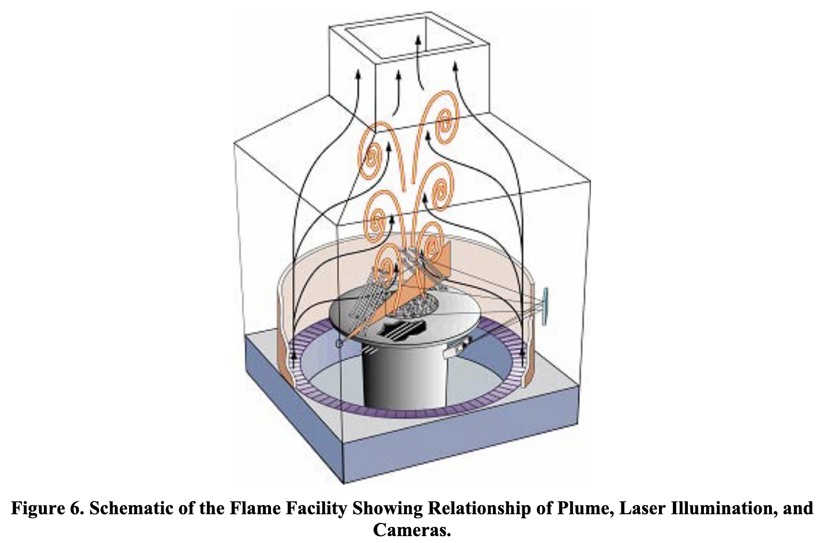
Tieszen et al. “Validation of a Simple Turbulence Model Suitable
for Closure of Temporally-Filtered Navier-Stokes Equations Using a Helium Plume”, SAND2005-3210

Slide 18
C
M
F
Hidden
Tieszen et al. “Validation of a Simple Turbulence Model Suitable
for Closure of Temporally-Filtered Navier-Stokes Equations Using a Helium Plume”, SAND2005-3210

Slide 19
C
M
F
xF
Tieszen et al. “Validation of a Simple Turbulence Model Suitable
for Closure of Temporally-Filtered Navier-Stokes Equations Using a Helium Plume”, SAND2005-3210

Slide 20
Tieszen et al. “Validation of a Simple Turbulence Model Suitable
for Closure of Temporally-Filtered Navier-Stokes Equations Using a Helium Plume”, SAND2005-3210

Slide 21
How Code Verification Can Guide Numerical Methods Elucidation

Slide 22
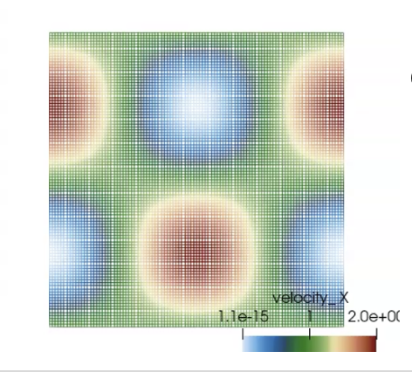
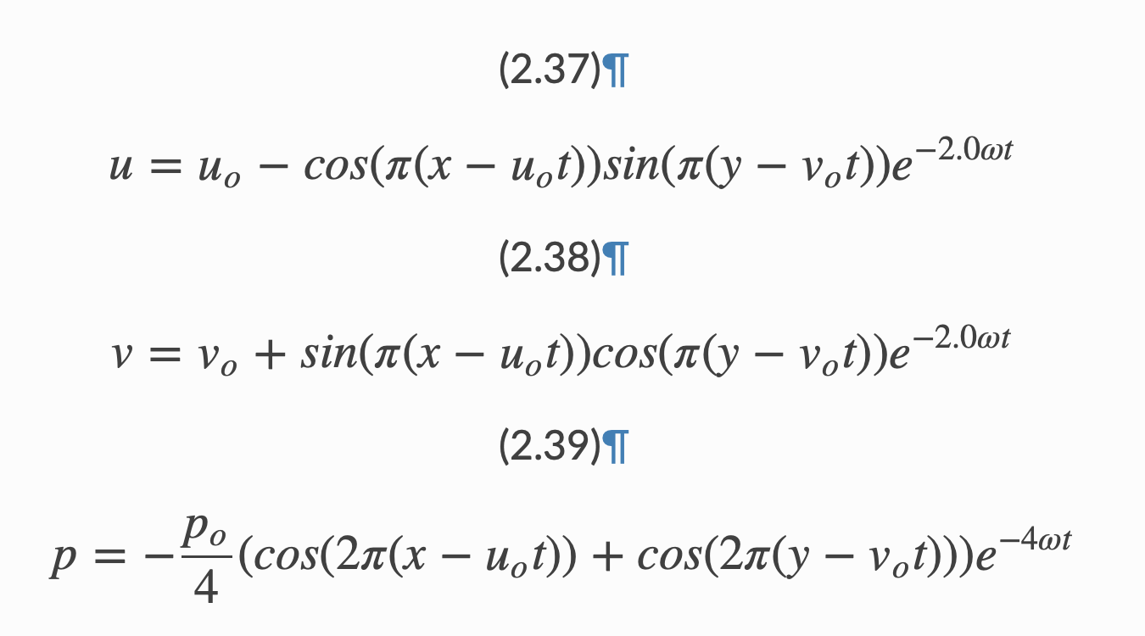
Consistent vs Lumped Mass Matrix
Goal: Explore the time accuracy of the consistent mass matrix approach on a structured mesh
Convecting Taylor Vortex Case Study: Analytical, transient verification problem
Process: Compute error at a specific time while refining mesh

Slide 23
Code or Conceptual Error? Part 1: Time Splitting
Case Study: An Algorithm is thought to be second-order-in-time accurate with one nonlinear iteration: True or False?
Issa, “Solution of the implicitly discretized fluid flow equations by operator splitting”, JCP (1985).
Advent of the “Pressure-implicit with Splitting of Operators”, or PISO
PISO is a scheme that defines a series of predictors and correctors in the context of a fully implicit solve
Conclusion?
Sometimes we code a method correctly, however, have a conceptual error in our understanding of whether or not a scheme is design-order accurate when run in the suggested manner

Slide 24
Code or Conceptual Error? Part 2: Boundary Conditions
Case Study: Using the convecting Taylor Vortex case, explore boundary conditions
Choice 1: Periodic with specified initial condition
Requires no formal boundary conditions
Choice 2: Inflow
Easy, velocity is specified as a Dirichlet
What about pressure? The default approach is to assume a zero normal pressure gradient (no-op) – similar to what would be found at a wall
A notion of a “spurious numerical boundary layer” (Gresho, 1995) shows a characteristic length δ ~ sqrt(νΔt) error
We also need to make sure that we are adequately converging the nonlinear system within the time step

Slide 25
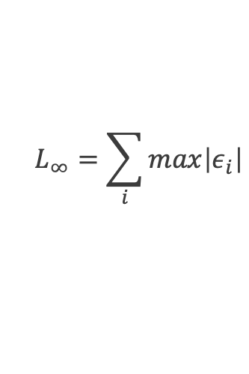
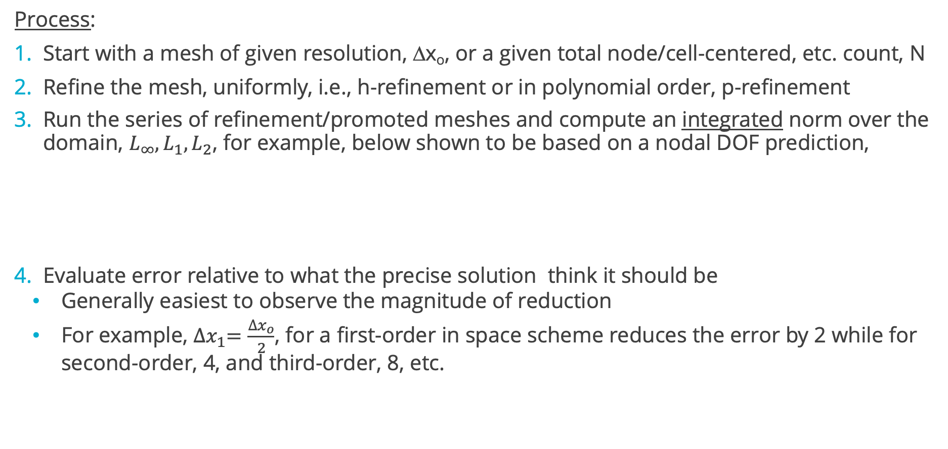
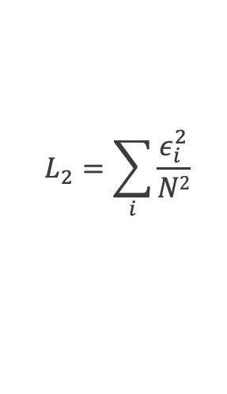
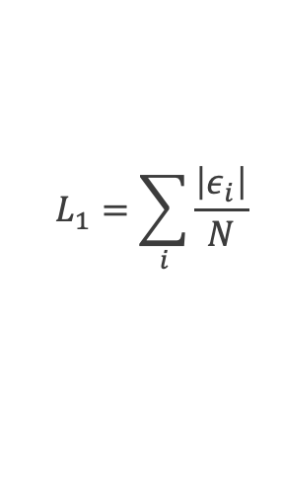
Spatial Verification Process
Process:
Start with a mesh of given resolution, Δx_{o}, or a given total node/cell-centered, etc. count, N
Refine the mesh, uniformly, i.e., h-refinement or in polynomial order, p-refinement
Run the series of refinement/promoted meshes and compute an integrated norm over the domain, $L_{∞}, L_{1}, L_{2}$, for example, below shown to be based on a nodal DOF prediction,
Evaluate error relative to what the precise solution think it should be
Generally easiest to observe the magnitude of reduction
For example, ${∆x}_{1}=\frac{{∆x}_{o}}{2}$, for a first-order in space scheme reduces the error by 2 while for second-order, 4, and third-order, 8, etc.
$$L_{∞}=\sum_{i}{max\left|ε_{i}\right|}$$
$$L_{1}=\sum_{i}{\frac{\left|ε_{i}\right|}{N}}$$
$$L_{2}=\sum_{i}{\frac{ε_{i}^{2}}{N2}}$$

Slide 26
Lurking, or Hidden Errors…
In some numerical implementations, an error can exist that is not easily found at a given mesh resolution
For example:
There may be a boundary error that manifests itself locally at a very small subset of the mesh
There may be an error that is a driven by the fidelity of the mesh (consider our specified pressure drop in a pipe example)
Other errors, e.g., for a discrete-ordinance method, we have an underlying quadrature error
s^{k}_{j}

Slide 27
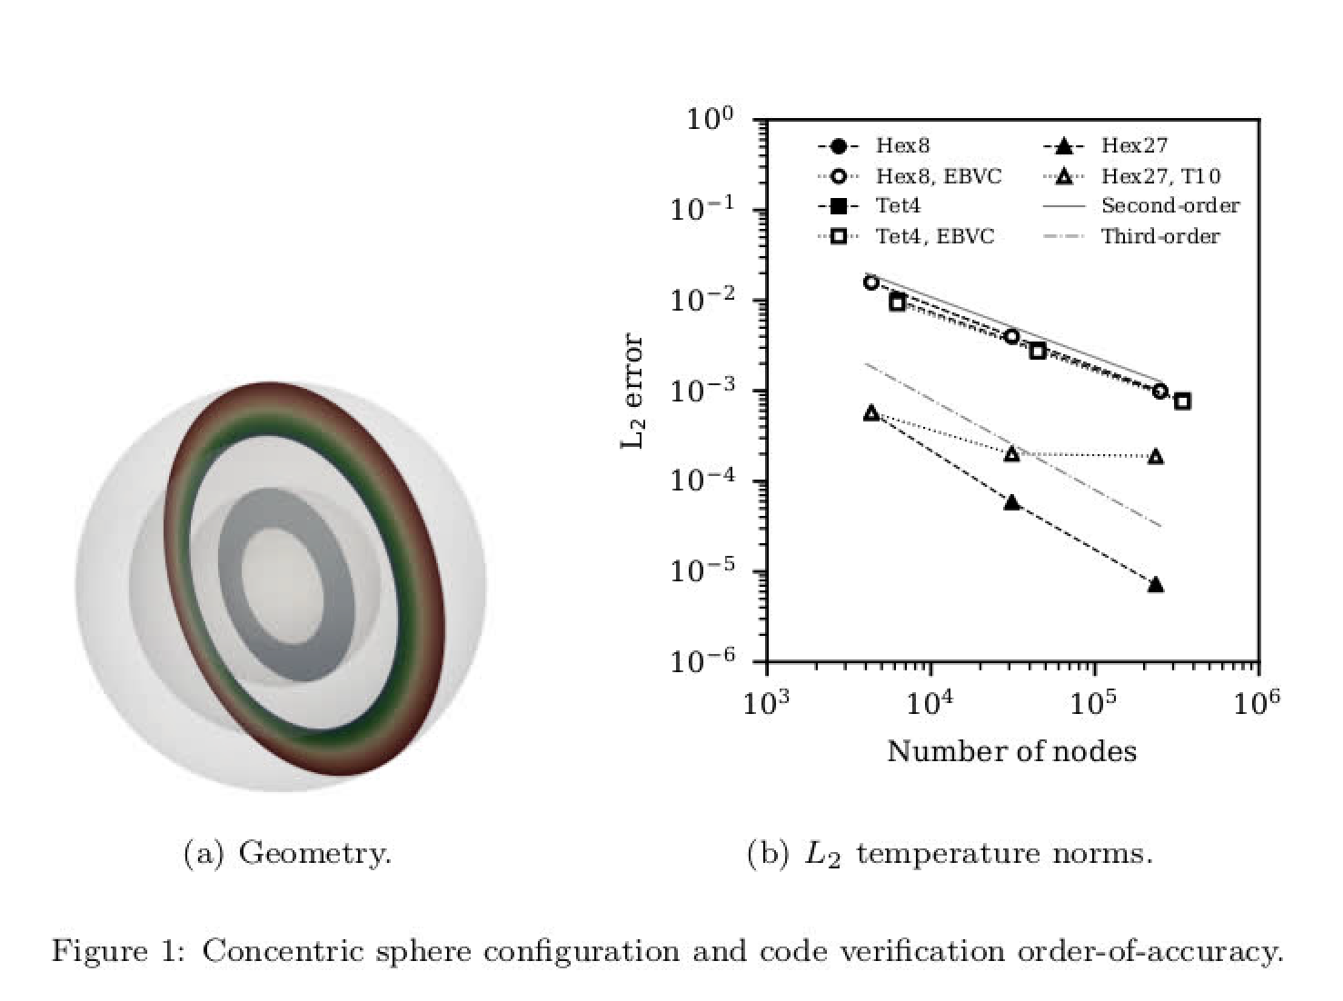
Lurking, or Hidden Errors…
In some numerical implementations, an error can exist that is not easily found at a given mesh resolution
For example:
There may be a boundary error that manifests itself locally at a very small subset of the mesh
There may be an error that is a driven by the fidelity of the mesh (consider our specified pressure drop in a pipe example)
Other errors, e.g., for a discrete-ordinance method, we have an underlying quadrature error
s^{k}_{j}

Slide 28
Lurking, or Hidden Errors…
In some numerical implementations, an error can exist that is not easily found at a given mesh resolution
For example:
There may be a boundary error that manifests itself locally at a very small subset of the mesh
There may be an error that is a driven by the fidelity of the mesh (consider our specified pressure drop in a pipe example)
Other errors, e.g., for a discrete-ordinance method, we have an underlying quadrature error
s^{k}_{j}
Quadrature error at given quadrate order

Slide 29
Temporal Verification: Fixed Spatial Resolution; Reduced Timestep
On a given mesh, compute error at a given time:

Slide 30
Temporal Verification: Fixed Spatial Resolution; Reduced Timestep
On a given mesh, compute error at a given time:

Slide 31
Temporal Verification: Fixed Spatial Resolution; Reduced Timestep
On a given mesh, compute error at a given time:

Slide 32
Temporal Verification: Fixed Spatial Resolution; Reduced Timestep
On a given mesh, compute error at a given time:
At a given mesh, the mesh
spacing is fixed and, eventually,
manifests itself

Slide 33
Temporal Verification: Reduction of Timestep as Mesh Is Refined
On a series of uniform mesh refinements, compute error at a given time while reducing time step
Must ensure that the spatial error does not dominate:
P1/P1
P2/P2
P1/P2
P2/P1
Traveling Vortex

Slide 34
Temporal Verification: Reduction of Timestep as Mesh Is Refined
On a series of uniform mesh refinements, compute error at a given time while reducing time step
Must ensure that the spatial error does not dominate:
P1/P1
P2/P2
P1/P2
P2/P1
Traveling Vortex
P2/P1

Slide 35
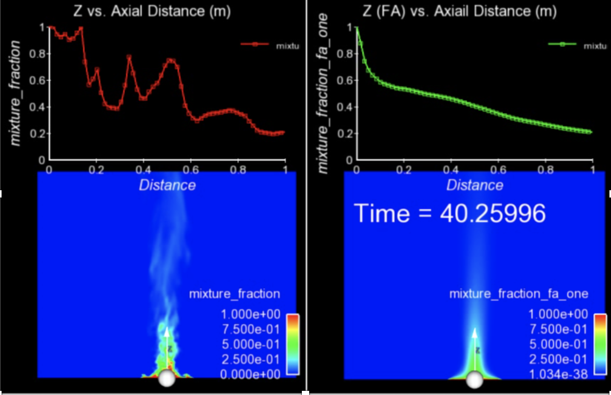
Finally…. For Transient Flows, Averaging is Required
The bane of turbulent validation: converged statistics require many flow-through times
Statistical convergence of a given simulation may require many flow-through-times; additional source of uncertainty and/or requirement for quantification of solution convergence

Slide 36
Essentials of Code Verification: Review
Taxonomy: One verifies code and validates models
Code verification establishes the numerical accuracy of the underlying discretization for the given partial differential equation set
Code verification seeks to provide the temporal and spatial accuracy of the underlying discretization approach
For temporal discretization error,
A two-state Backward Euler time integrator should be first-order in time, specifically the error should scale with Δt
A three-state BDF2 time integrator should scale with Δt²
A multi-stake Runge-Kutta schemes can achieve higher-order accuracy
For spatial discretization error,
A method is design-order if the observed order of accuracy is Δx^{P+1}, where P is the underlying basis polynomial order
Oberkampf and Trucano, Verification and validation in computational fluid dynamics, Progress in Aerospace Sciences,
Volume 38, Issue 3, 2002, https://doi.org/10.1016/S0376-0421(02)00005-2.

